Slide 1

Machine Learning Basics
www.BigDataTrunk.com

Slide 2
Welcome to
Machine Learning Basics
PRE-WORK
Sign-in for Attendance
Put Name on Name tag
Download Anaconda (python v3.x)
https://www.anaconda.com/distribution/
Download material from:
https://tinyurl.com/yyr9lqnu
www.BigDataTrunk.com

Slide 3
Agenda
01
Machine Learning Overview
02
ML Algorithms
03
Model Selection
04
Python Libraries for ML
05
Automated ML
06
Next Steps

Slide 4
Logistics
Timing – 9 to 4 PM PST
Lunch – Approx. noon to 1 PM PST
Periodic Breaks – At logical points

Slide 5
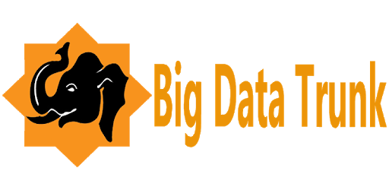

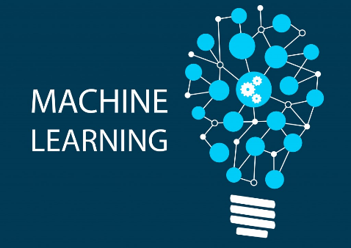





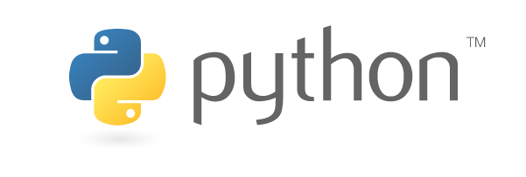


Stanford &

Slide 6
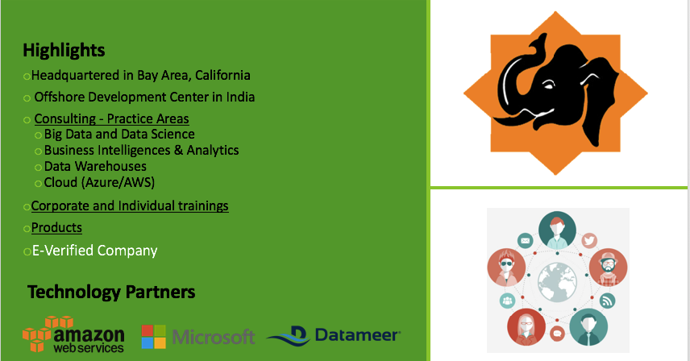
Big Data Trunk

Slide 7
Introductions

Slide 8
Machine Learning

Slide 9
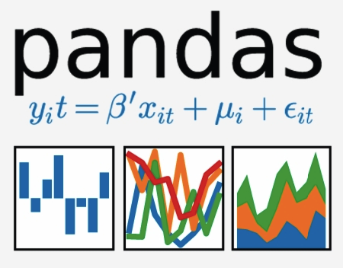
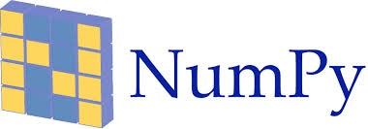


Python Libraries for Data Analysis

Slide 10
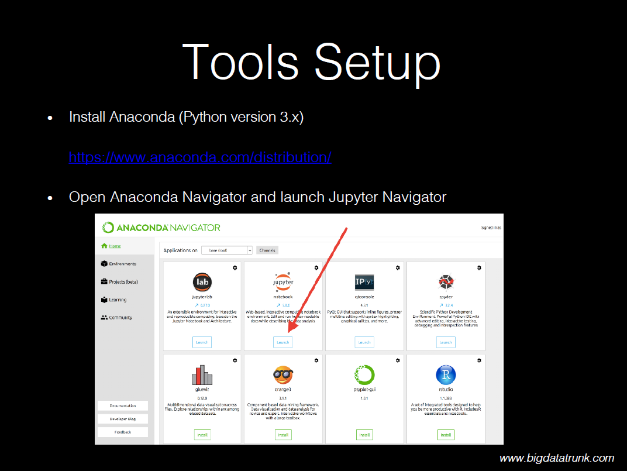

Slide 11
Hands-on
Jupyter Notebook & Python

Slide 12
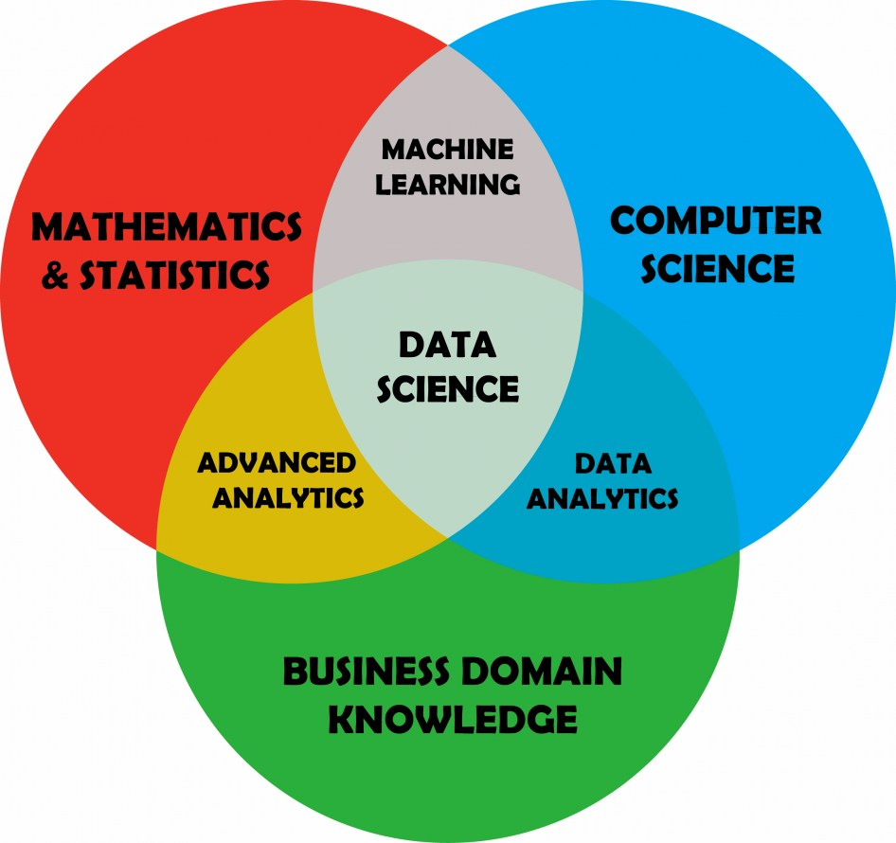
Data Science

Slide 13
The Data Science Process (DIAPERS)
Define Problem Statement
Ingest Data
Analyze Data
Prepare Data for ML
Evaluate Models
Refine Model
Ship It

Slide 14
Define Problem Statement

Slide 15
Ask good questions:
answerable
actionable
specific
narrow

Slide 16
Ingest Data

Slide 17
Google Dataset Search
toolbox.google.com/datasetsearch
Kaggle
kaggle.com/datasets
ProPublica Data Store
propublica.org/datastore
World Bank Open Data
data.worldbank.org

Slide 18
Some challenges with data
Insufficient quantity of data
Non-representative data
Poor quality of data
Irrelevant features

Slide 19
Machine Learning
Algorithms

Slide 20
Model Selection

Slide 21
Hands-on
Pandas

Slide 22
Scikit-learn
Demonstration

Slide 23
Survey Time
http://ttseval.stanford.edu
Course Code – ITS-1903

Slide 24



Automated ML

Slide 25
Summary
01
Machine Learning Overview
02
ML Algorithms
03
Model Selection
04
Python Libraries for ML
05
Automated ML
06
Next Steps

Slide 26
Next steps
Make a custom plan for yourself to continue this journey
Improve some of your skills (Stats, Python, ML, Domain, etc.)
Take some additional courses
Try a Kaggle.com competition
Work on a personal project to improve understanding

Slide 27
Useful Data Science and Machine Learning books for beginners to intermediate:
Book | Author
Data Smart: Using Data Science to Transform Information Into Insight | John W. Foreman
Naked Statistics: Stripping the Dread from the Data | Charles Wheelan
An Introduction to Statistical Learning | Robert Tibshirani and Trevor Hastie
Python Machine Learning | Sebastian Raschka and Vahid Mirjalili
The Hundred-Page Machine Learning Book | Andriy Burkov

Slide 28
Stanford Upcoming Training
Click here for latest schedule

Slide 29
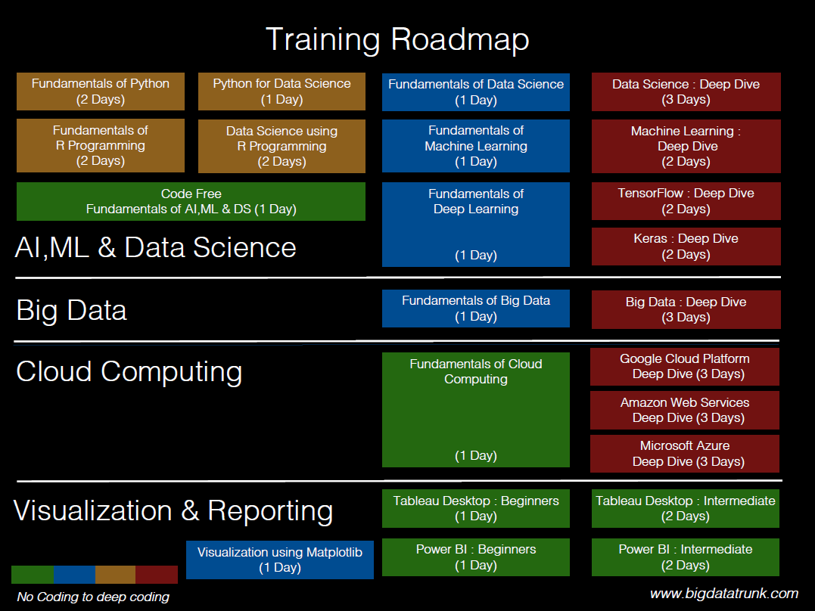

Slide 30
